Slide 1
Algorithms and Data Structures
Lecture III
Simonas Šaltenis
Nykredit Center for Database Research
Aalborg University
simas@cs.auc.dk

Slide 2
This Lecture
Divide-and-conquer technique for algorithm design. Example – the merge sort.
Writing and solving recurrences

Slide 3
Divide and Conquer
Divide-and-conquer method for algorithm design:
  Divide: If the input size is too large to deal with in a straightforward manner, divide the problem into two or more disjoint subproblems
  Conquer: Use divide and conquer recursively to solve the subproblems
  Combine: Take the solutions to the subproblems and “merge” these solutions into a solution for the original problem

Slide 4
Merge Sort Algorithm
Divide: If S has at least two elements (nothing needs to be done if S has zero or one elements), remove all the elements from S and put them into two sequences, S₁ and S₂ , each containing about half of the elements of S. (i.e. S₁ contains the first ⎡n/2⎤ elements and S₂ contains the remaining ⎣n/2⎦ elements).
Conquer: Sort sequences S₁ and S₂ using Merge Sort.
Combine: Put back the elements into S by merging the sorted sequences S₁ and S₂ into one sorted sequence

Slide 5
Merge Sort: Algorithm
Merge-Sort(A, p, r)
if p < r then
q←(p+r)/2
Merge-Sort(A, p, q)
Merge-Sort(A, q+1, r)
Merge(A, p, q, r)
Merge(A, p, q, r)
Take the smallest of the two topmost elements of sequences A[p..q] and A[q+1..r] and put into the resulting sequence. Repeat this, until both sequences are empty. Copy the resulting sequence into A[p..r].

Slide 6
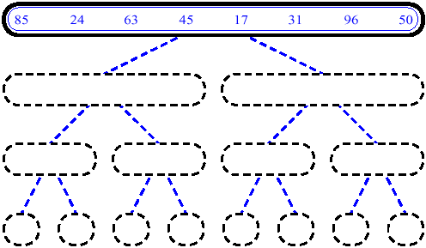
MergeSort (Example) - 1

Slide 7
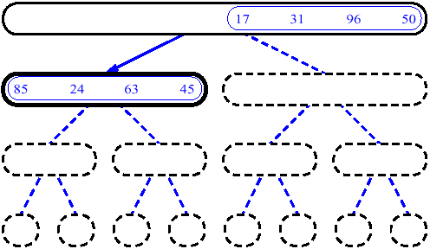
MergeSort (Example) - 2

Slide 8
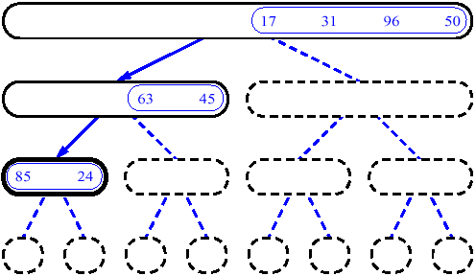
MergeSort (Example) - 3

Slide 9
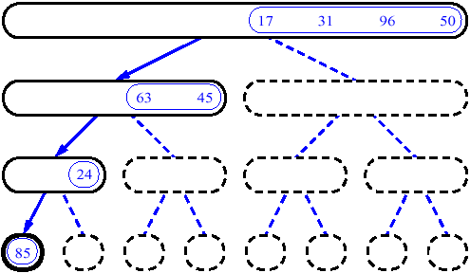
MergeSort (Example) - 4

Slide 10
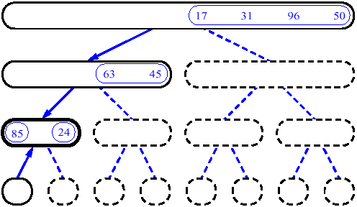
MergeSort (Example) - 5

Slide 11
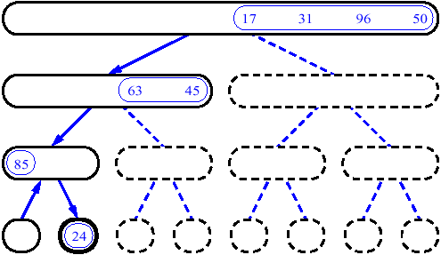
MergeSort (Example) - 6

Slide 12
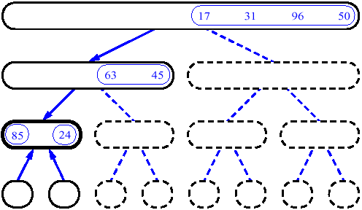
MergeSort (Example) - 7

Slide 13
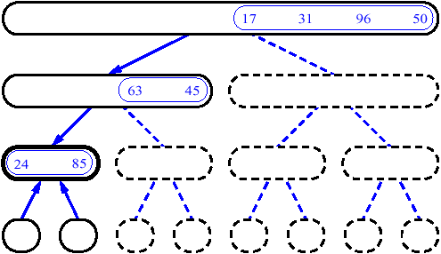
MergeSort (Example) - 8

Slide 14
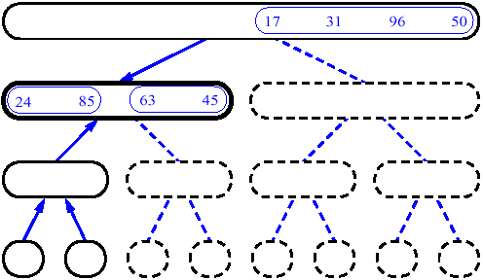
MergeSort (Example) - 9

Slide 15
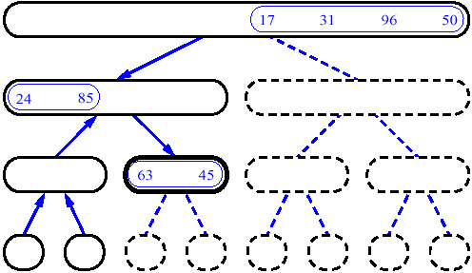
MergeSort (Example) - 10

Slide 16
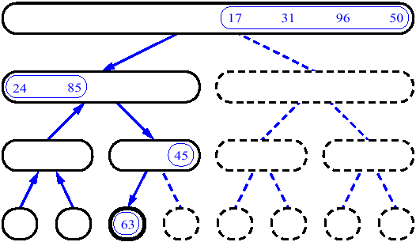
MergeSort (Example) - 11

Slide 17
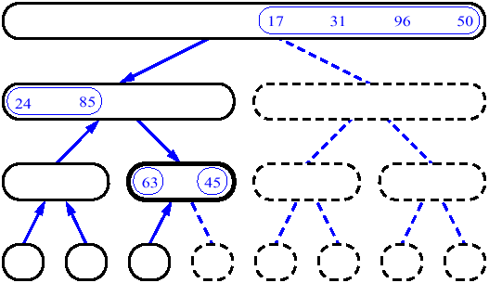
MergeSort (Example) - 12

Slide 18
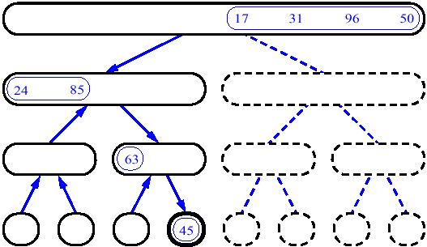
MergeSort (Example) - 13

Slide 19
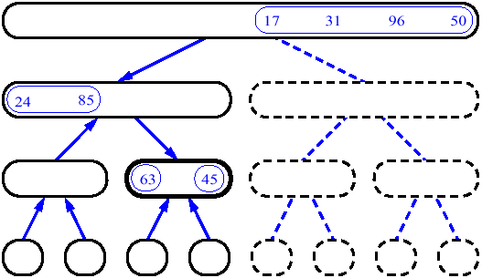
MergeSort (Example) - 14

Slide 20
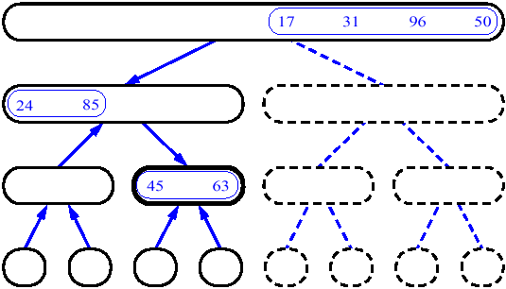
MergeSort (Example) - 15

Slide 21
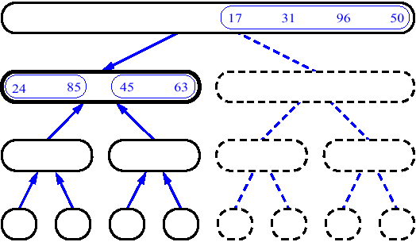
MergeSort (Example) - 16

Slide 22
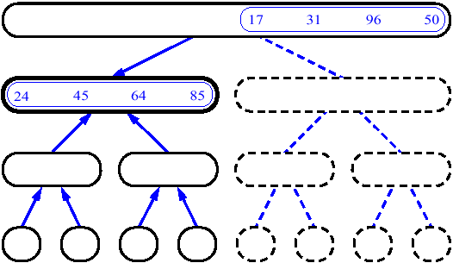
MergeSort (Example) - 17

Slide 23
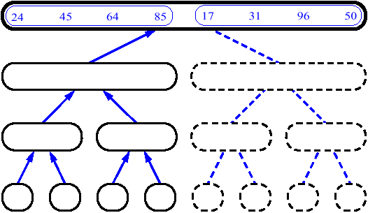
MergeSort (Example) - 18

Slide 24
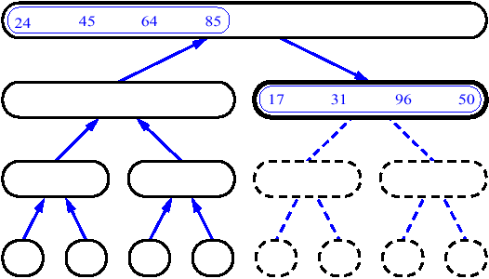
MergeSort (Example) - 19

Slide 25
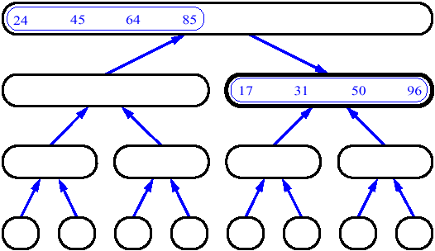
MergeSort (Example) - 20

Slide 26
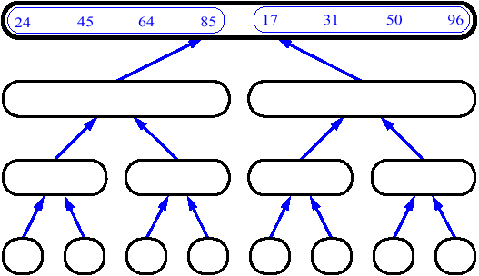
MergeSort (Example) - 21

Slide 27
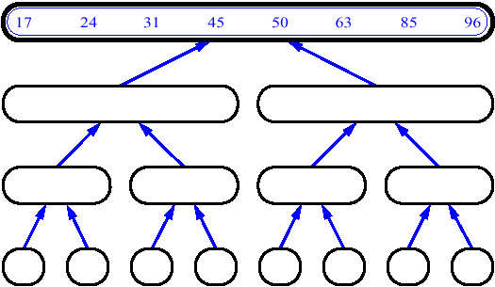
MergeSort (Example) - 22

Slide 28
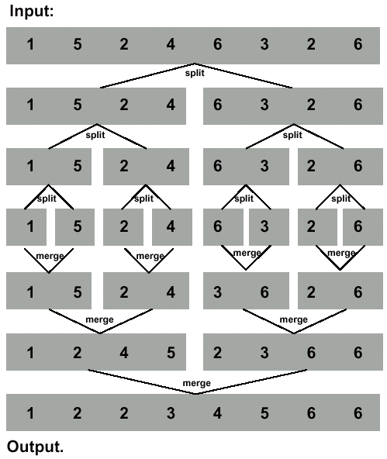
Merge Sort Revisited
To sort n numbers
  if n=1 done!
  recursively sort 2 lists of numbers ⎣n/2⎦ and ⎡n/2⎤ elements
  merge 2 sorted lists in Θ(n) time
Strategy
  break problem into similar (smaller) subproblems
  recursively solve subproblems
  combine solutions to answer

Slide 29
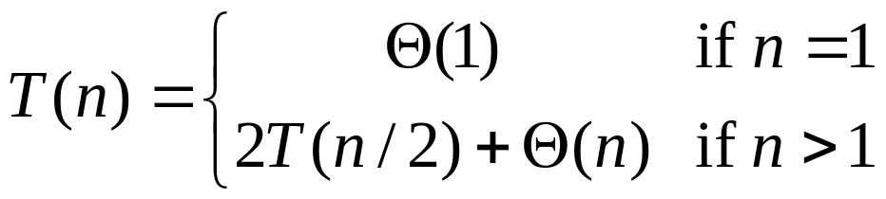
Recurrences
Running times of algorithms with Recursive calls can be described using recurrences
A recurrence is an equation or inequality that describes a function in terms of its value on smaller inputs
Example: Merge Sort

Slide 30
Solving Recurrences
Repeated substitution method
  Expanding the recurrence by substitution and noticing patterns
Substitution method
  guessing the solutions
  verifying the solution by the mathematical induction
Recursion-trees
Master method
  templates for different classes of recurrences

Slide 31
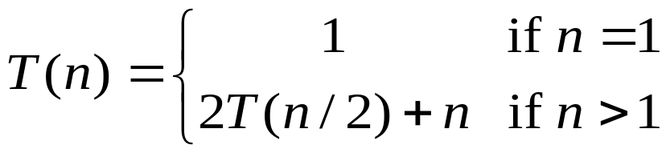
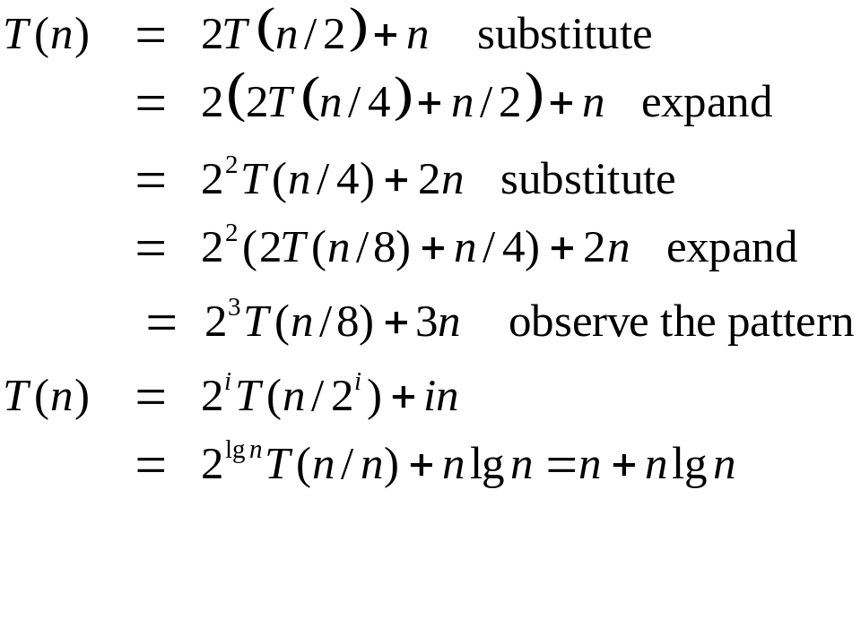
Repeated Substitution Method
Let’s find the running time of merge sort (let’s assume that n=2^{b}, for some b).

Slide 32
Repeated Substitution Method
The procedure is straightforward:
  Substitute
  Expand
  Substitute
  Expand
  …
  Observe a pattern and write how your expression looks after the i-th substitution
  Find out what the value of i (e.g., lgn) should be to get the base case of the recurrence (say T(1))
  Insert the value of T(1) and the expression of i into your expression

Slide 33
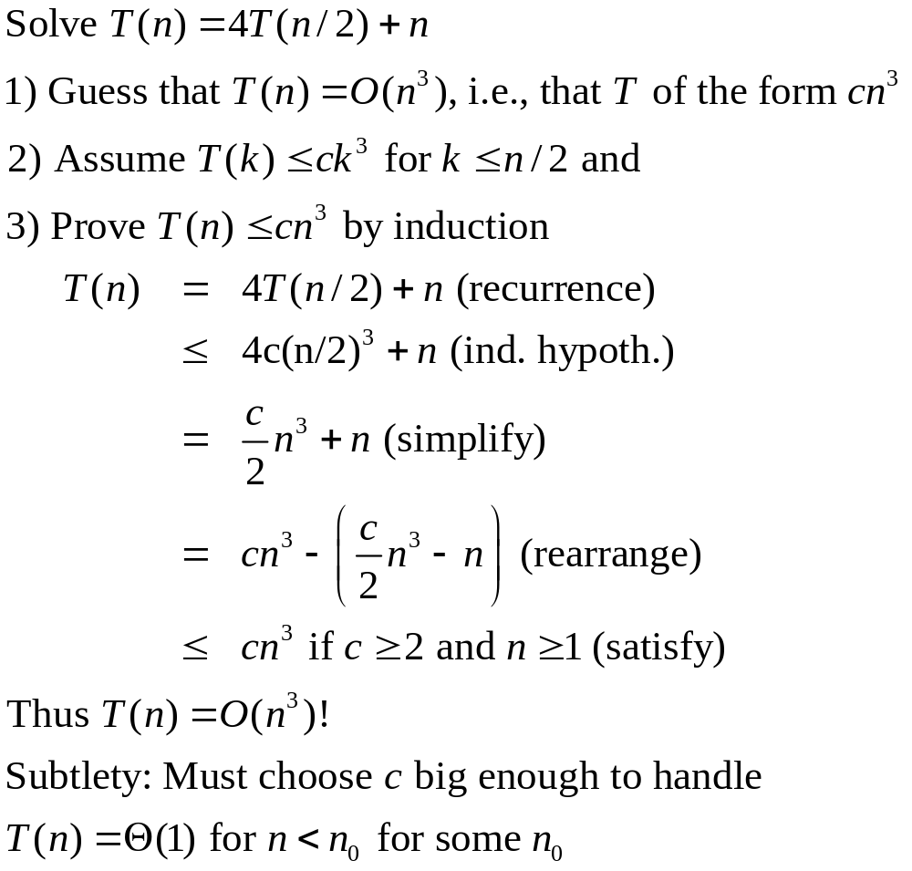
Substitution method

Slide 34
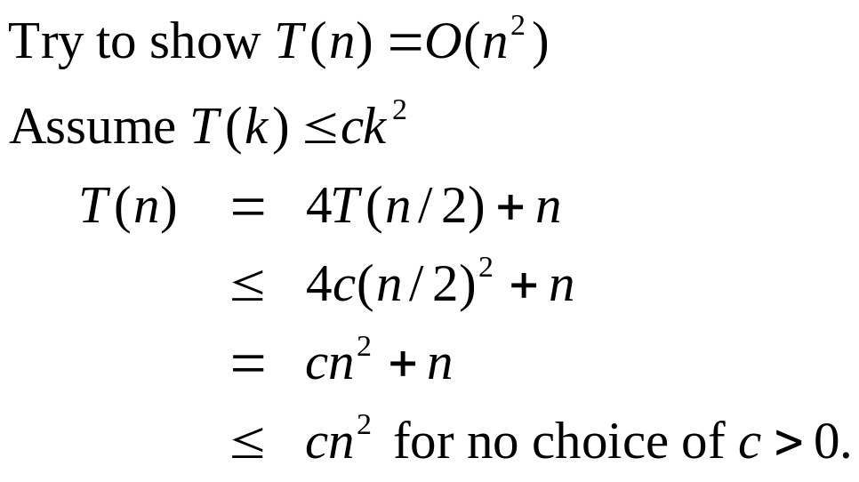
Substitution Method
Achieving tighter bounds

Slide 35


Substitution Method (2)
The problem? We could not rewrite the equality
as:
in order to show the inequality we wanted
Sometimes to prove inductive step, try to strengthen your hypothesis
  T(n) ≤ (answer you want) - (something > 0)

Slide 36
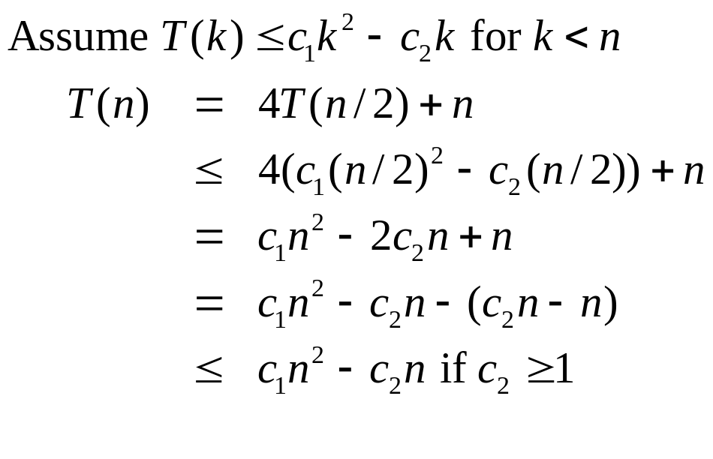
Substitution Method (3)
Corrected proof: the idea is to strengthen the inductive hypothesis by subtracting lower-order terms!

Slide 37
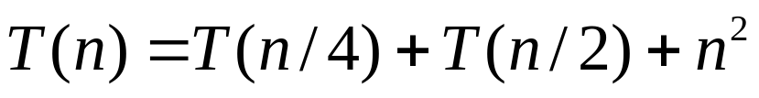
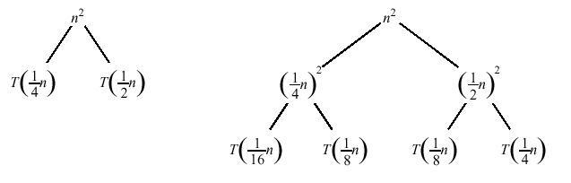
Recursion Tree
A recursion tree is a convenient way to visualize what happens when a recurrence is iterated
Construction of a recursion tree

Slide 38
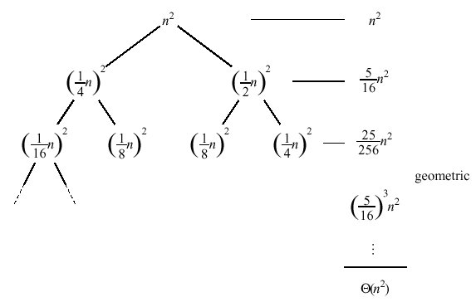
Recursion Tree (2)

Slide 39

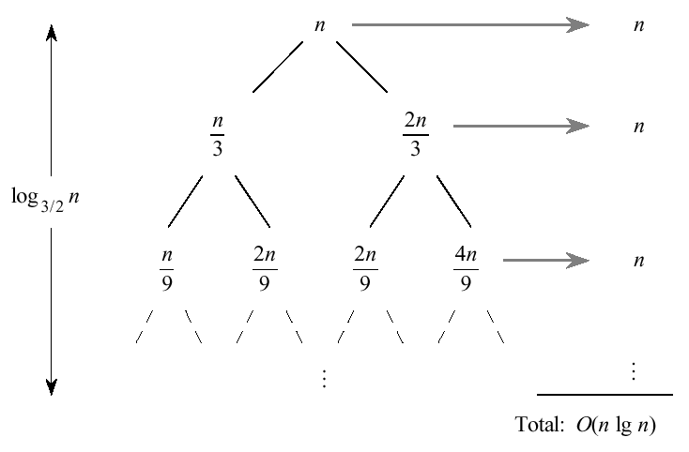
Recursion Tree (3)

Slide 40


Master Method
The idea is to solve a class of recurrences that have the form
a >= 1 and b > 1, and f is asymptotically positive!
Abstractly speaking, T(n) is the runtime for an algorithm and we know that
  a subproblems of size n/b are solved recursively, each in time T(n/b)
  f(n) is the cost of dividing the problem and combining the results. In merge-sort

Slide 41
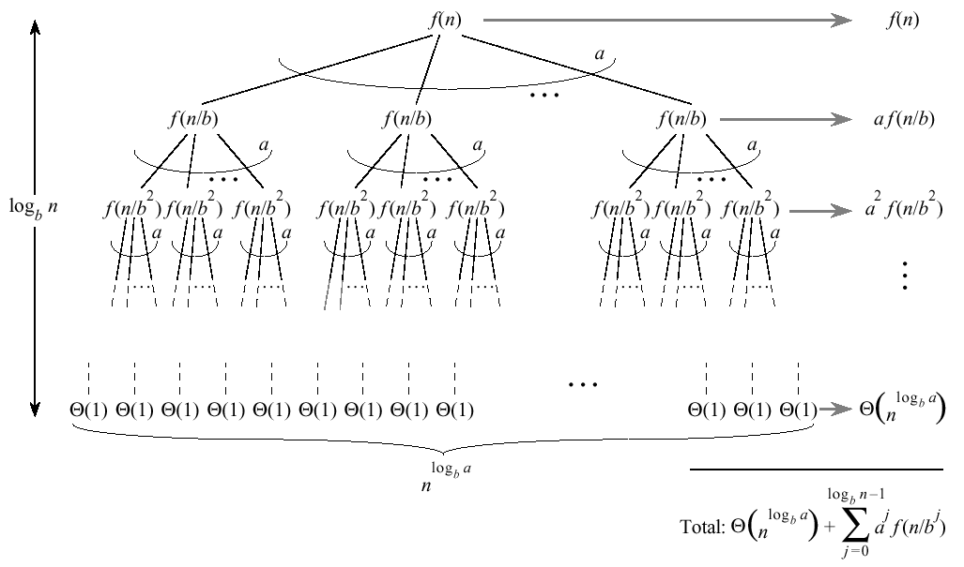
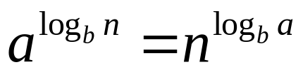
Master Method (2)
Split problem into a parts at log_{b}n levels. There are leaves

Slide 42
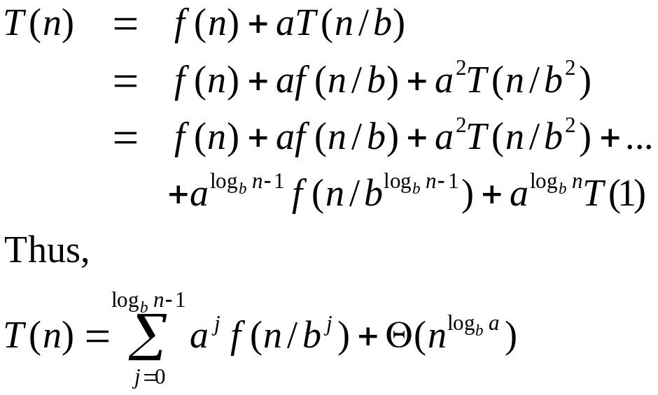
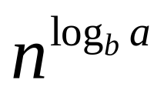
Master Method (3)
Number of leaves:
Iterating the recurrence, expanding the tree yields
  The first term is a division/recombination cost (totaled across all levels of the tree)
  The second term is the cost of doing all subproblems of size 1 (total of all work pushed to leaves)

Slide 43

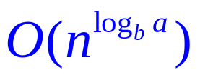
MM Intuition
Three common cases:
  Running time dominated by cost at leaves
  Running time evenly distributed throughout the tree
  Running time dominated by cost at root
Consequently, to solve the recurrence, we need only to characterize the dominant term
In each case compare with

Slide 44
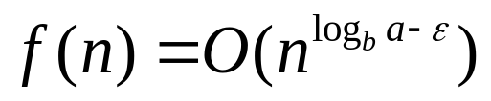

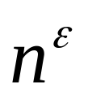
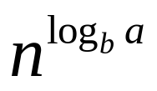
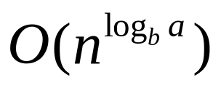
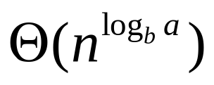
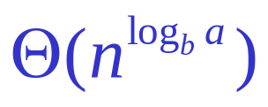
MM Case 1
for some constant
  f(n) grows polynomially (by factor ) slower than
The work at the leaf level dominates
  Summation of recursion-tree levels
  Cost of all the leaves
  Thus, the overall cost

Slide 45
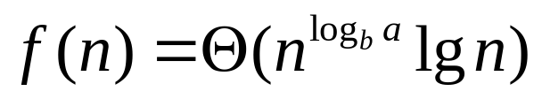
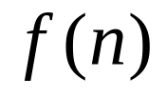
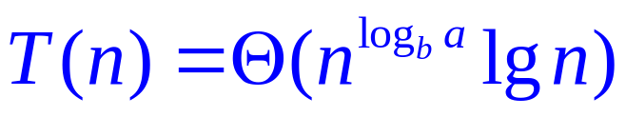
MM Case 2
  and are asymptotically the same
The work is distributed equally throughout the tree
  (level cost) × (number of levels)

Slide 46
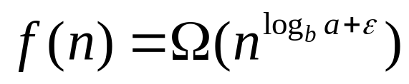
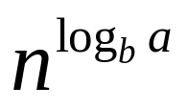

MM Case 3
for some constant
  Inverse of Case 1
  f(n) grows polynomially faster than
  Also need a regularity condition
The work at the root dominates

Slide 47
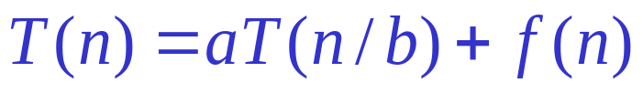

Master Theorem Summarized
Given a recurrence of the form
The master method cannot solve every recurrence of this form; there is a gap between cases 1 and 2, as well as cases 2 and 3

Slide 48

Strategy
Extract a, b, and f(n) from a given recurrence
Determine
Compare f(n) and asymptotically
Determine appropriate MT case, and apply
Example merge sort

Slide 49

Examples
Binary-search(A, p, r, s):
q←(p+r)/2
if A[q]=s then return q
else if A[q]>s then
Binary-search(A, p, q-1, s)
else Binary-search(A, q+1, r, s)

Slide 50

Examples (2)

Slide 51

Examples (3)

Slide 52
Next Week
Sorting
  QuickSort
  HeapSort

